Slide 1
What I learned at school, Grandma
Presented by:
Lanting Su
Preetham Reddy Pathi
Rushil Manglik

Slide 2
Linear Regression
Let’s talk about the question you care about a lot:
WHEN WOULD I GET MARRIED? So I thought why not explain it based on a very interesting topic I learnt at school.
Grandma an age old fact that everyone knows is that salary ~ years of experience.

Slide 3
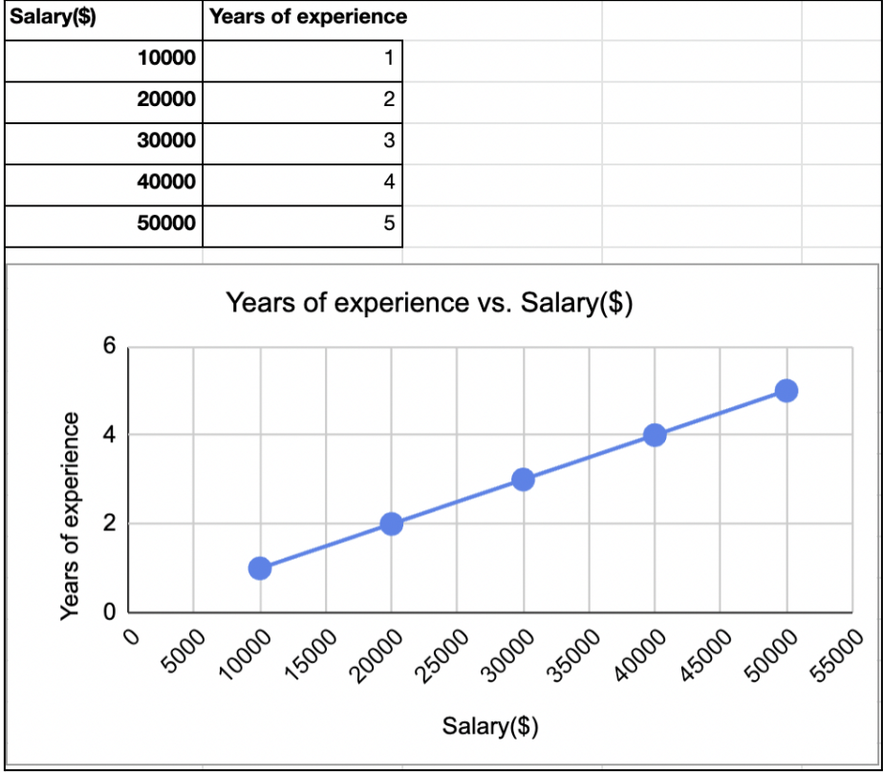
Simple Linear Regression
salary = β0 + β1(years of exp)

Slide 4

But do you know what concept was behind this?

Slide 5
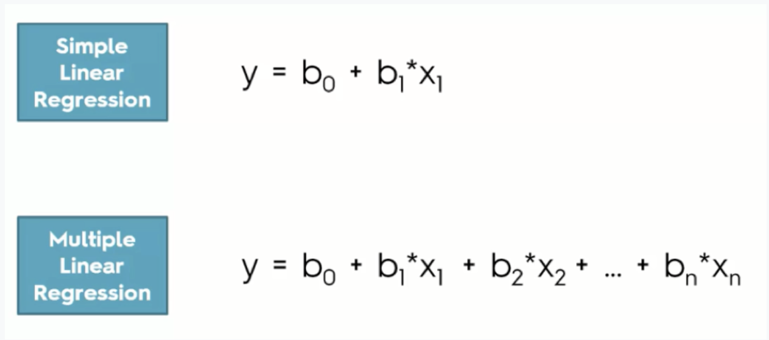
Linear Regression ! How does it relate to this topic?

Slide 6
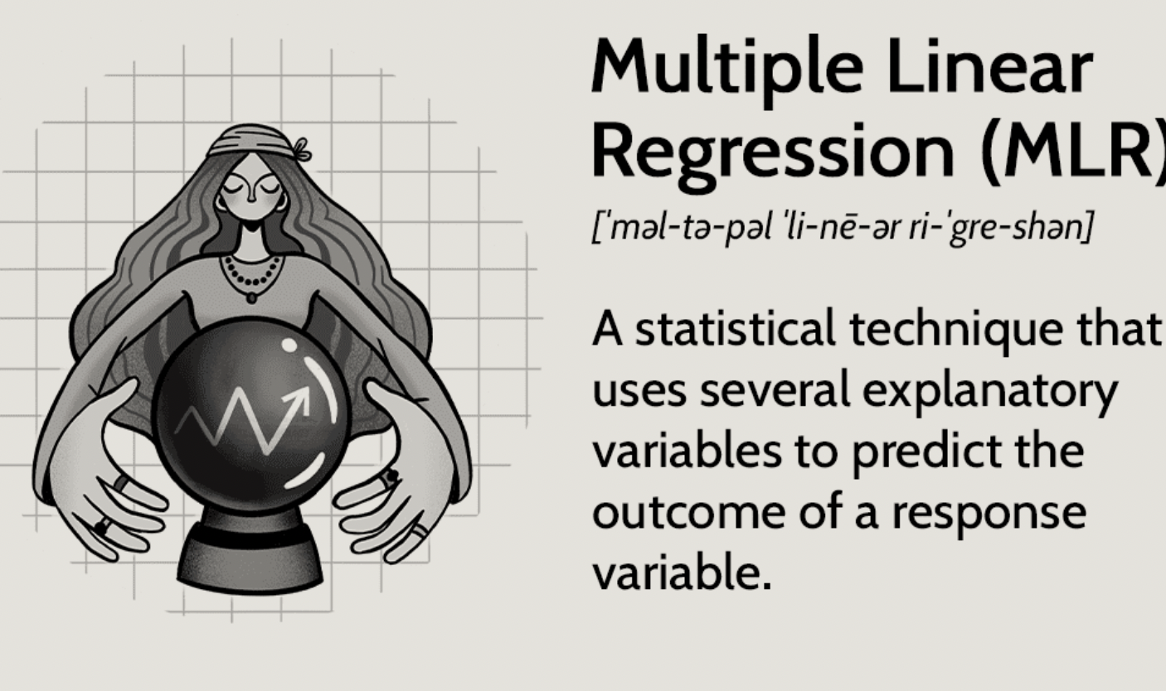
What is MLR ???

Slide 7
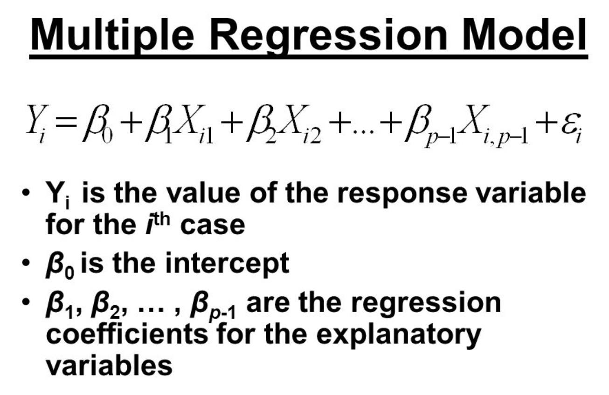
What does a Multiple Regression Model looks like?

Slide 8
Apparently, I can create a MLR model about marriage age
Marriage_age = b0 + b1*education_level
+ b2*salary
+ b3*race
+ b4*parents_marriage_age
+ b5*COVID
+ b6*region
+ b7*friends_marriage_age + ei

Slide 9
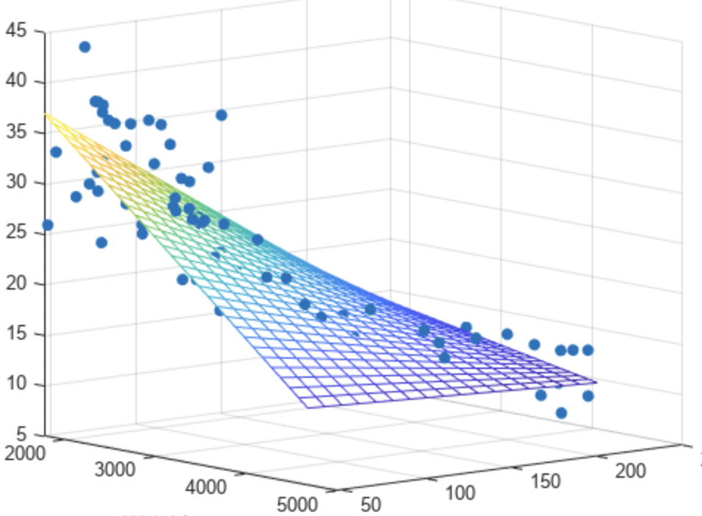
2 variables Linear Regression

Slide 10
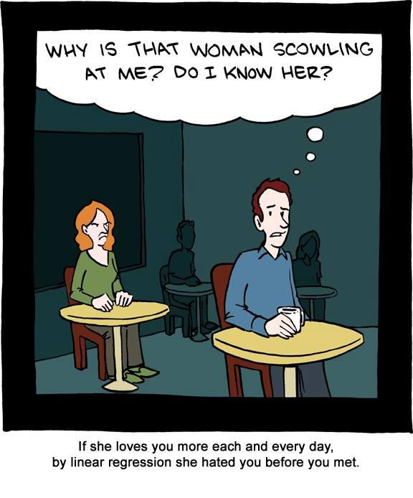
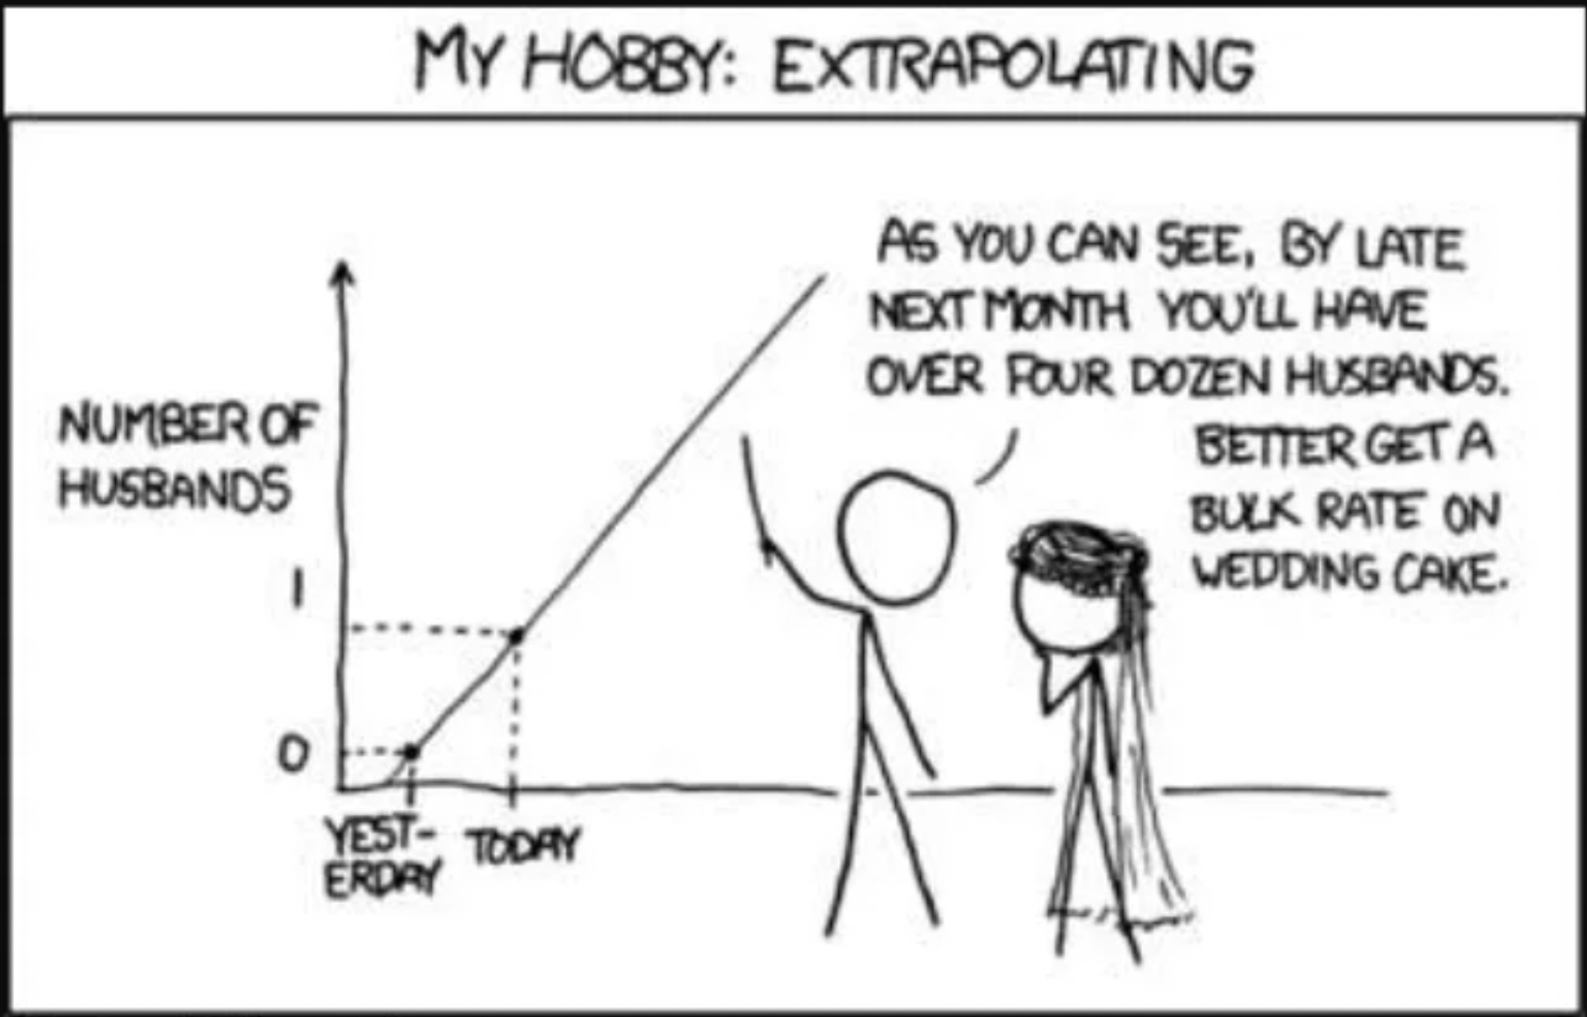
Some Issues with Regression

Slide 11
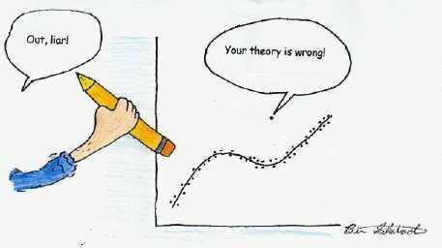
Contd.

Slide 12
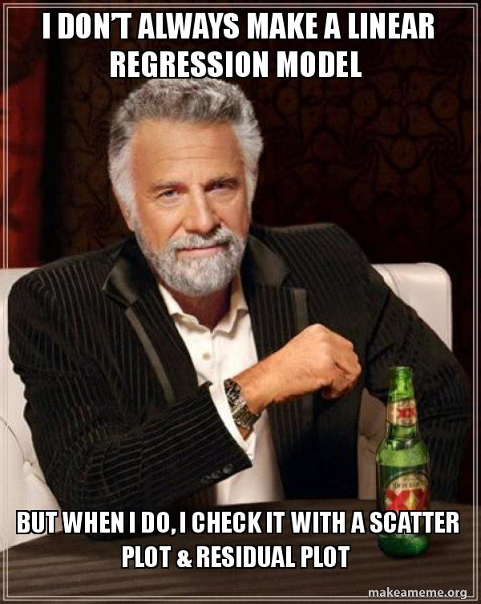
Why is such an old model still used?

Slide 13
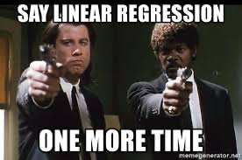

Slide 14
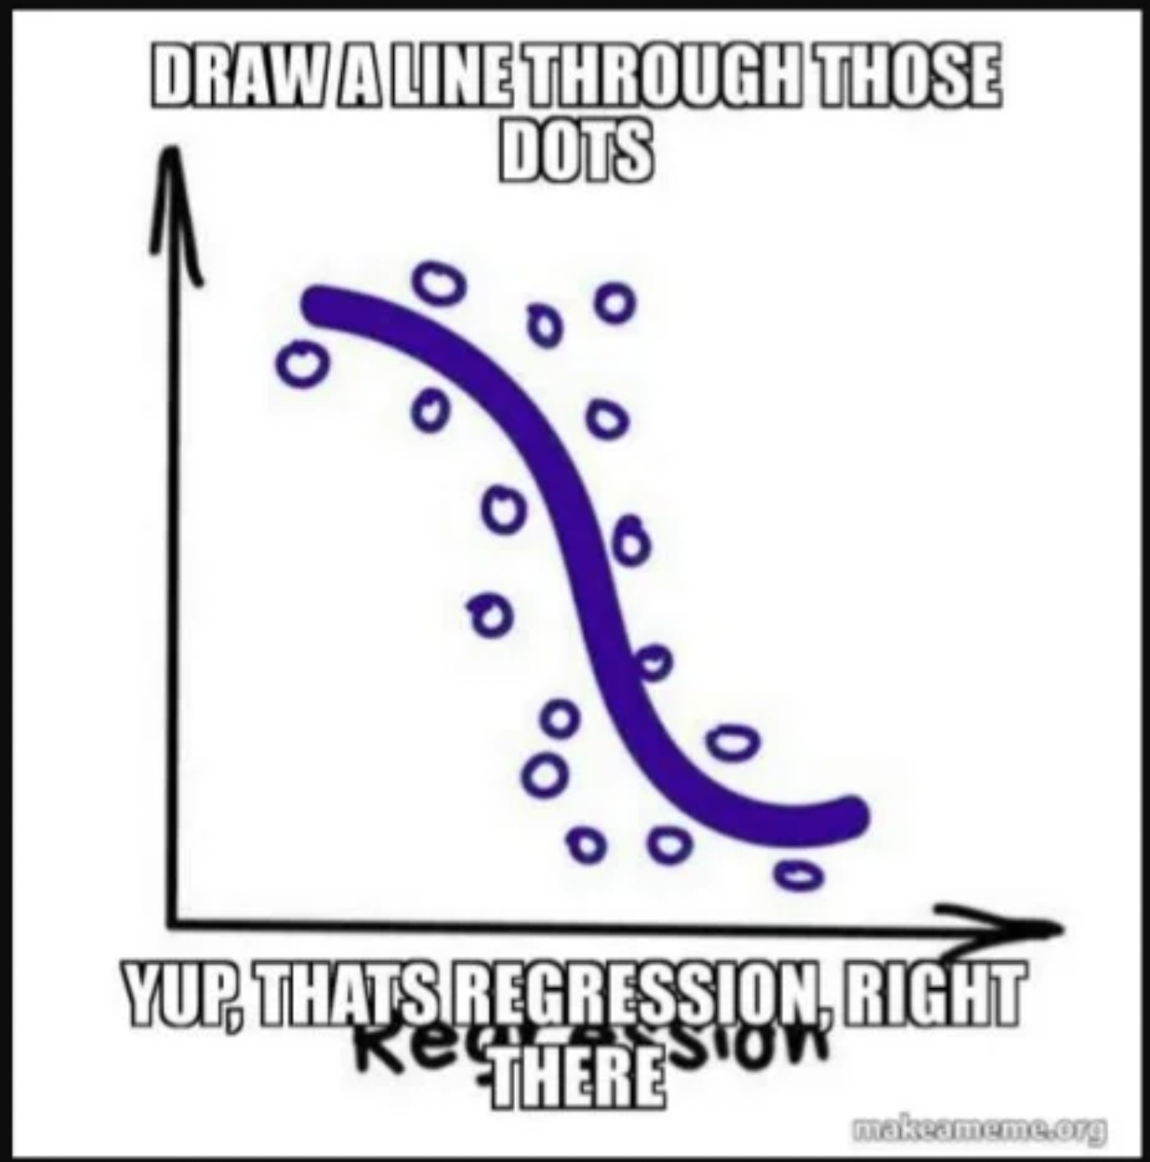
Basically

Slide 15
References
https://www.statology.org/linear-regression-real-life-examples/
https://www.slideshare.net/CodeOps/understanding-ml-through-memes-harsh-ccdays
https://seaborn.pydata.org/tutorial/regression.html
https://stats.stackexchange.com/questions/219579/what-is-wrong-with-extrapolation
https://medium.com/data-science-group-iitr/linear-regression-back-to-basics-e4819829d78b

